Slide 1
INT247 Machine Learning Foundations
Lecture #2.0
Machine Learning Classifiers using
Scikit-learn

Slide 2

Introduction to scikit-learn
Machine Learning in Python
Simple and Effective tools for data mining and data Analysis
Built on Numpy, Scipy, Matplotlib
Open source, commercially usable - BSD license
Accessible to everybody, reusable in various contexts

Slide 3
How to Install?
Python Idle
pip install scikit-learn
Anconda
conda install scikit-learn
Jupyter Note Book
!pip install scikit-learn

Slide 4

No Free Lunch Theorem
No Classifier works best across all possible scenarios.

Slide 5
Choosing a classification Algorithm?
Parameters for choosing a classification algorithm
Performance may depends on
Number of features
Number of samples
The amount of noise in dataset
Classes are linearly separable or NOT.

Slide 6
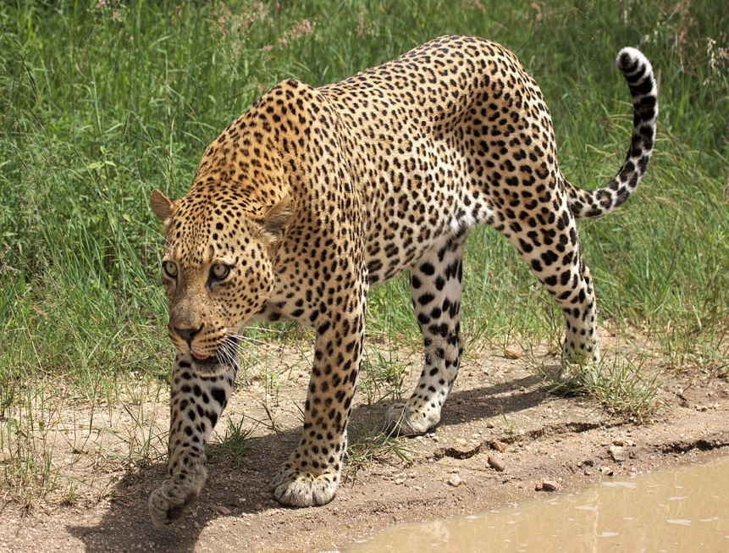
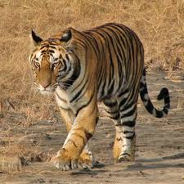
Selection of Features
Features to classify dissimilar Object
Easy??
Tiger Vs Leopard

Slide 7
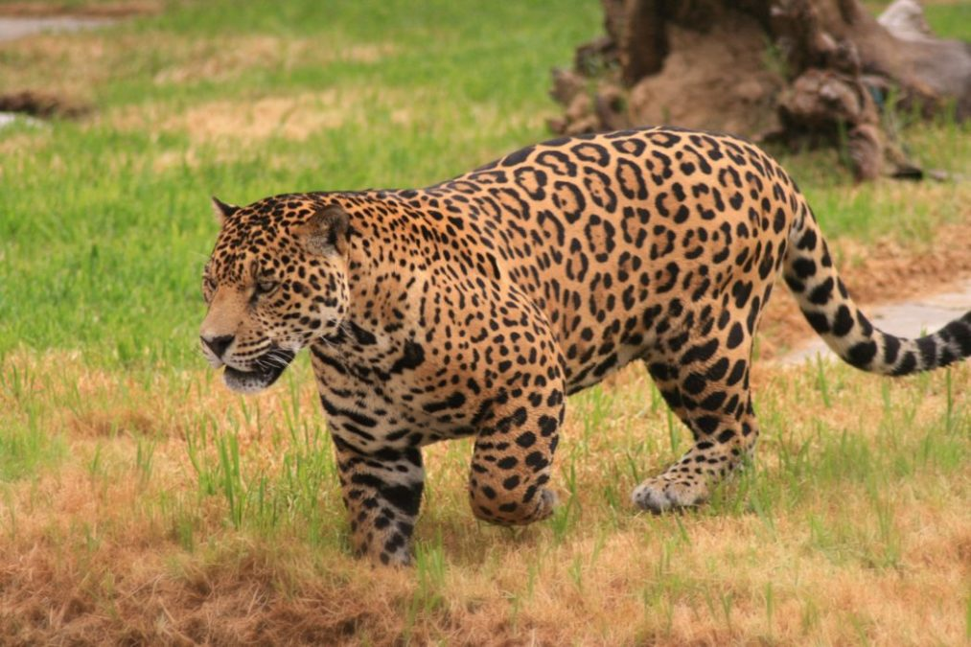
Selection of Features
Features to classify similar Object
??
Jaguar Vs Leopard

Slide 8
Training a machine learning algorithm
Training a machine learning algorithm can be summarized in 5 main steps.
Selection of features
Choosing a performance Metrics
Choosing a classifier and Optimization Algorithm.
Evaluating the performance of model
Tuning the algorithm.

Slide 9
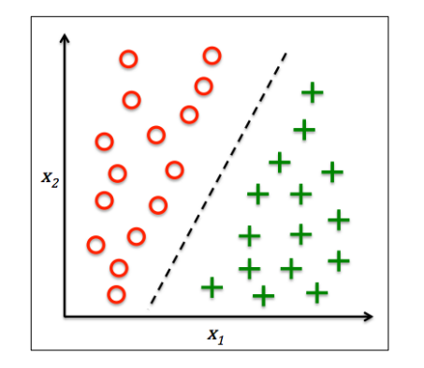
Perceptorn
2 class classifier
Linear separable patterns

Slide 10
Training Perceptron using scikit-learn
Major Steps involved
Load dataset
Divide the data in train and test
Feature Scaling
Train Perceptron model
Check accuracy
Plot Decision Boundary

Slide 11
Available Datasets in scikit
load_boston()
load_iris()
load_diabetes()
load_digits()
load_linnerud()
load_wine()
load_breast_cancer()
Notes:
A

Slide 12
Load Dataset
from sklearn import datasets
Iris=datasets.load_iris()
x=iris.data
y=iris.target

Slide 13
Split data in train and test
from sklearn.model_selection import train_test_split
x_train, x_test, y_train, y_test = train_test_split(x,y,test_size=0.2,random_state=0)
print(np.shape(x))
print(np.shape(x_train))
print(np.shape(x_test))

Slide 14
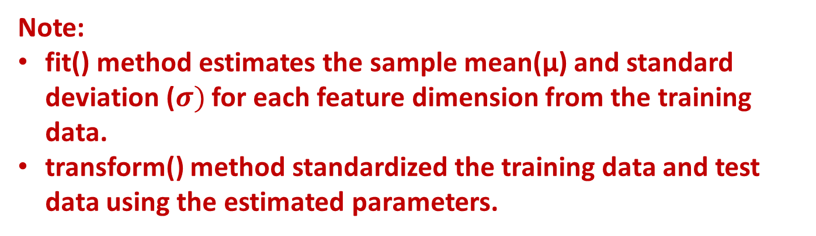
Feature Scaling
from sklearn.preprocessing import StandardScaler
sc=StandardScaler()
sc.fit(x_train)
x_train_std=sc.transform(x_train)
x_test_std=sc.transform(x_test)
Note:
fit() method estimates the sample mean(µ) and standard deviation ($σ)$ for each feature dimension from the training data.
transform() method standardized the training data and test data using the estimated parameters.

Slide 15
Train Perceptron Model
from sklearn.linear_model import Perceptron
ppn=Perceptron(eta0=0.1, random_state=0)
ppn.fit(x_train_std, y_train)
Note:
If learning rate is too large, then algorithm will overshoot the global cost minimum.
If learning rate is too small, then algorithm requires more epochs until convergence.

Slide 16
Prediction on new data
y_pred=ppn.predict(x_test_std)
print(‘Misclassified Samples: %d‘ %(y_test != y_pred).sum())

Slide 17
Compute Accuracy
from sklearn.metrics import accuracy_score
print(‘Accuracy: %f ‘%accuracy_score(y_test,y_pred))

Slide 18
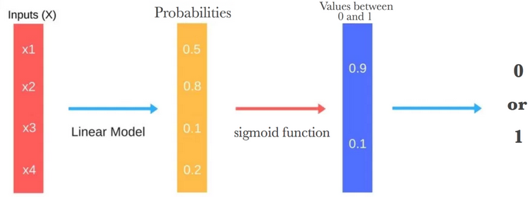
Logistic Regression and Conditional Probabilities
Measures the relationship between a target and one or more independent variables by plotting the dependent variable’s probability score.
For example:
To predict whether an email is spam or not.
Whether the tumor is malignant or not.

Slide 19
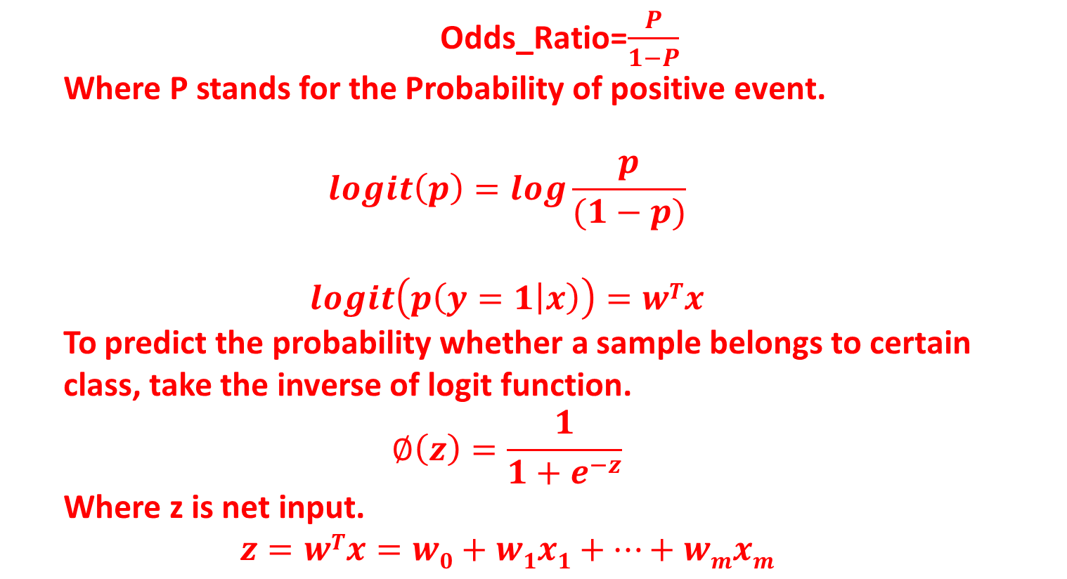
Odds Ratio
Odds_Ratio=$\frac{P}{1−P}$
Where P stands for the Probability of positive event.
$$logit\left(p\right)=log\frac{p}{(1−p)}$$
$$logit\left(p\left(y=1 | x\right)\right)=wTx$$
To predict the probability whether a sample belongs to certain class, take the inverse of logit function.
$$∅\left(z\right)=\frac{1}{1+e^{−z}}$$
Where z is net input.
$$z=wTx=w0+w1x1+…+wmxm$$

Slide 20
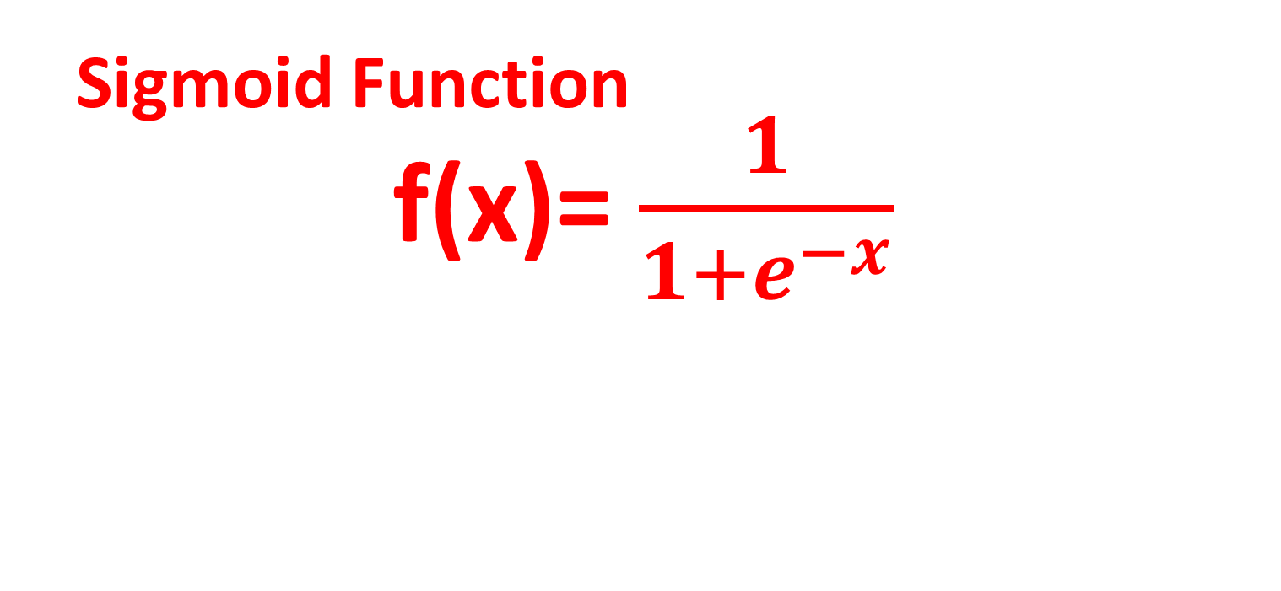
Activation Function in Logistic Regression
_{Sigmoid Function}
f(x)= $\frac{1}{1+e^{−x}}$

Slide 21
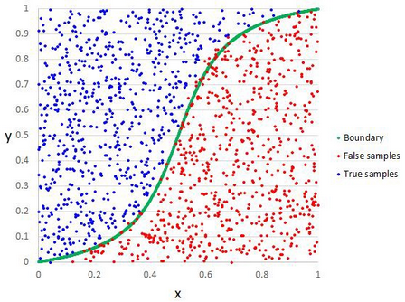
Decision Boundary
Set threshold to predict the class of sample.
Can be linear or non-linear.
Increase polynomial order to get complex decision boundary.

Slide 22
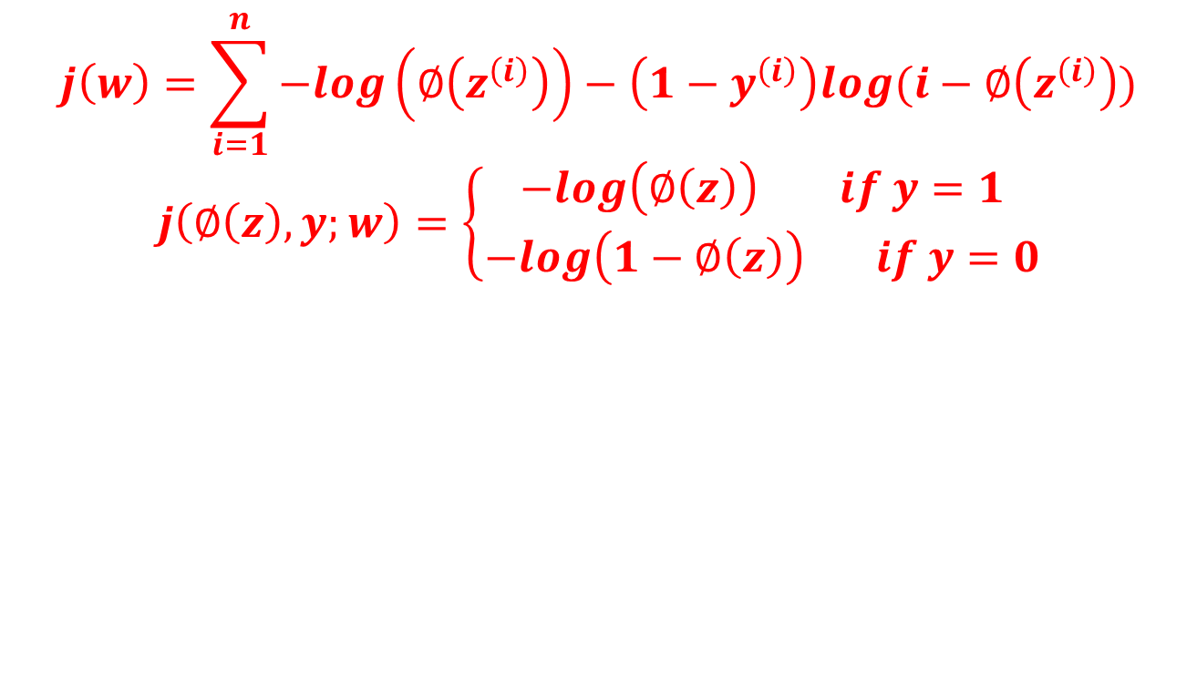
Cost Function
$$j\left(w\right)=\sum_{i=1}^{n}{−log\left(∅\left(z^{\left(i\right)}\right)\right)−\left(1−y^{\left(i\right)}\right)log(i−∅\left(z^{\left(i\right)}\right))}$$
$$j\left(∅\left(z\right),y;w\right)=\left\{\begin{aligned}−log\left(∅\left(z\right)\right) if y=1 \\ −log\left(1−∅\left(z\right)\right) if y=0\end{aligned}\right.$$

Slide 23
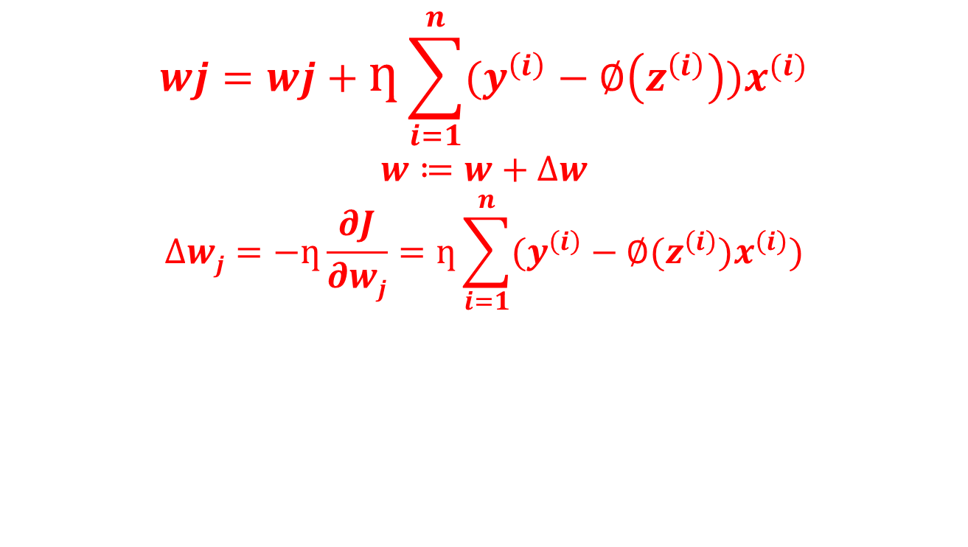

Weight Updating in Logistic Regression
$$wj=wj+ƞ\sum_{i=1}^{n}{(y^{\left(i\right)}−∅\left(z^{\left(i\right)}\right))x^{(i)}}$$
$$w≔w+∆w$$
$$∆wj=−ƞ\frac{∂J}{∂wj}=ƞ\sum_{i=1}^{n}{(y^{\left(i\right)}}−∅(z^{\left(i\right)})x^{\left(i\right)})$$

Slide 24
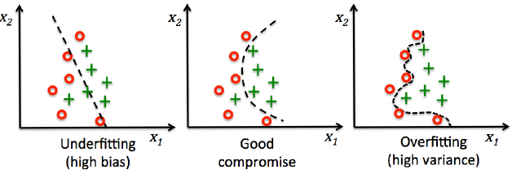
Over-fitting and Under-fitting
Note:
Bias measures how far off the predictions from the correct values.
Variance measures the consistency of the model prediction for a particular sample instance

Slide 25
Regularization
Handle collinearity
Filters out noise from data.
Prevent over-fitting.
Introduces additional information (bias) to penalize parameter weights.

Slide 26
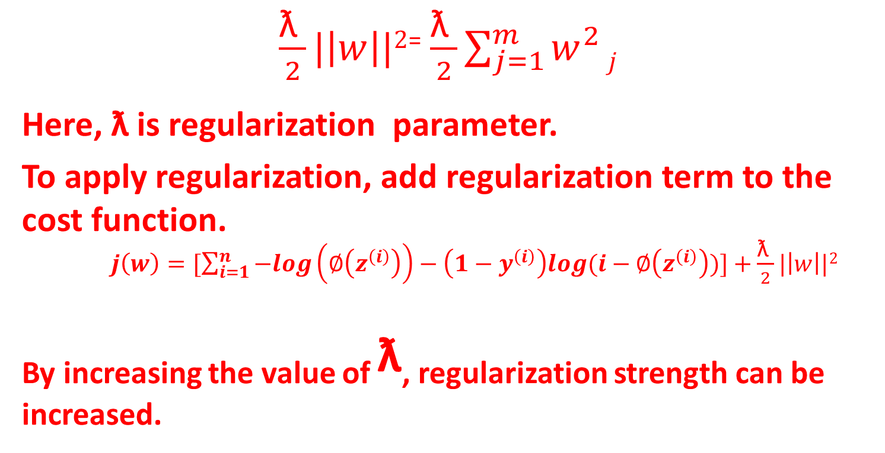
L2 Regularization
$\frac{\text{ƛ }}{2}|\left|w\right||2$⁼$\frac{\text{ƛ }}{2}\sum_{j=1}^{m}{w_{}^{2}}j$
Here, ƛ is regularization parameter.
To apply regularization, add regularization term to the cost function.
$j\left(w\right)=[\sum_{i=1}^{n}{−log\left(∅\left(z^{\left(i\right)}\right)\right)−\left(1−y^{\left(i\right)}\right)log(i−∅\left(z^{\left(i\right)}\right))]+}$$\frac{\text{ƛ }}{2}|\left|w\right||2$
_{By increasing the value of} $\text{ƛ}$, regularization strength can be increased.

Slide 27
Training logistic regression model with scikit-learn
from sklearn.linear_model import LogisticRegression
lr=LogisticRegression(C=1000, random_state=0)
lr.fit(x_train_std, y_train)

Slide 28
Advantages of logistic regression
Doesn’t require input features to be scaled.
Doesn’t require any tunning.
Easy to implement.

Slide 29
Disadvantages of logistic regression
Can’t solve non-linear problems.

Slide 30
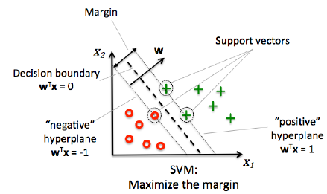
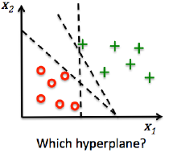
Support Vector Machine
Objective is to maximize the margin.

Slide 31
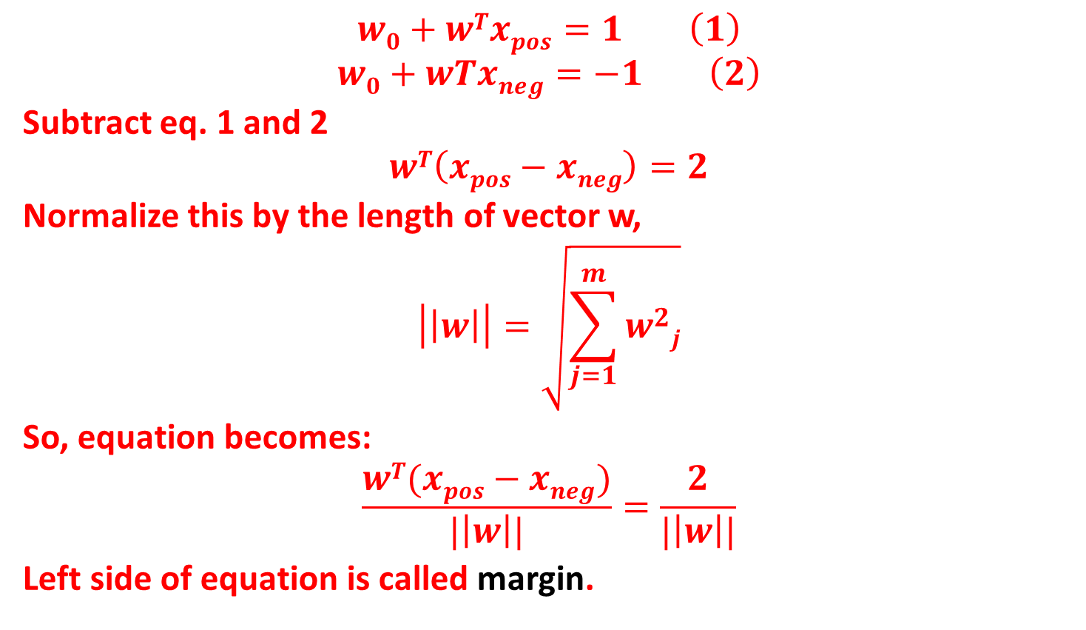
Maximum margin
$$w0+wTxpos=1 \left(1\right)$$
$$w0+wTxneg=−1 \left(2\right)$$
Subtract eq. 1 and 2
$$wT\left(xpos−xneg\right)=2$$
Normalize this by the length of vector w,
$$\left|\left|w\right|\right|=\sqrt{\sum_{j=1}^{m}{w_{}^{2}j}}$$
So, equation becomes:
$$\frac{wT(xpos−xneg)}{|\left|w\right||}=\frac{2}{|\left|w\right||}$$
Left side of equation is called margin.

Slide 32
Non-linear Separable Data

Slide 33
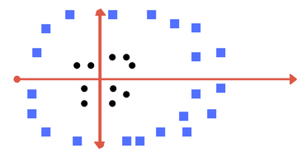
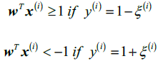
Non-linear separable case
Slack variables are added for nonlinearly separable data to allow convergence.
Positive values slack variables are added to the linear constraints:

Slide 34
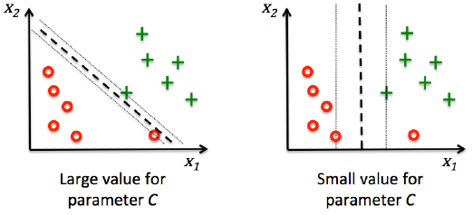
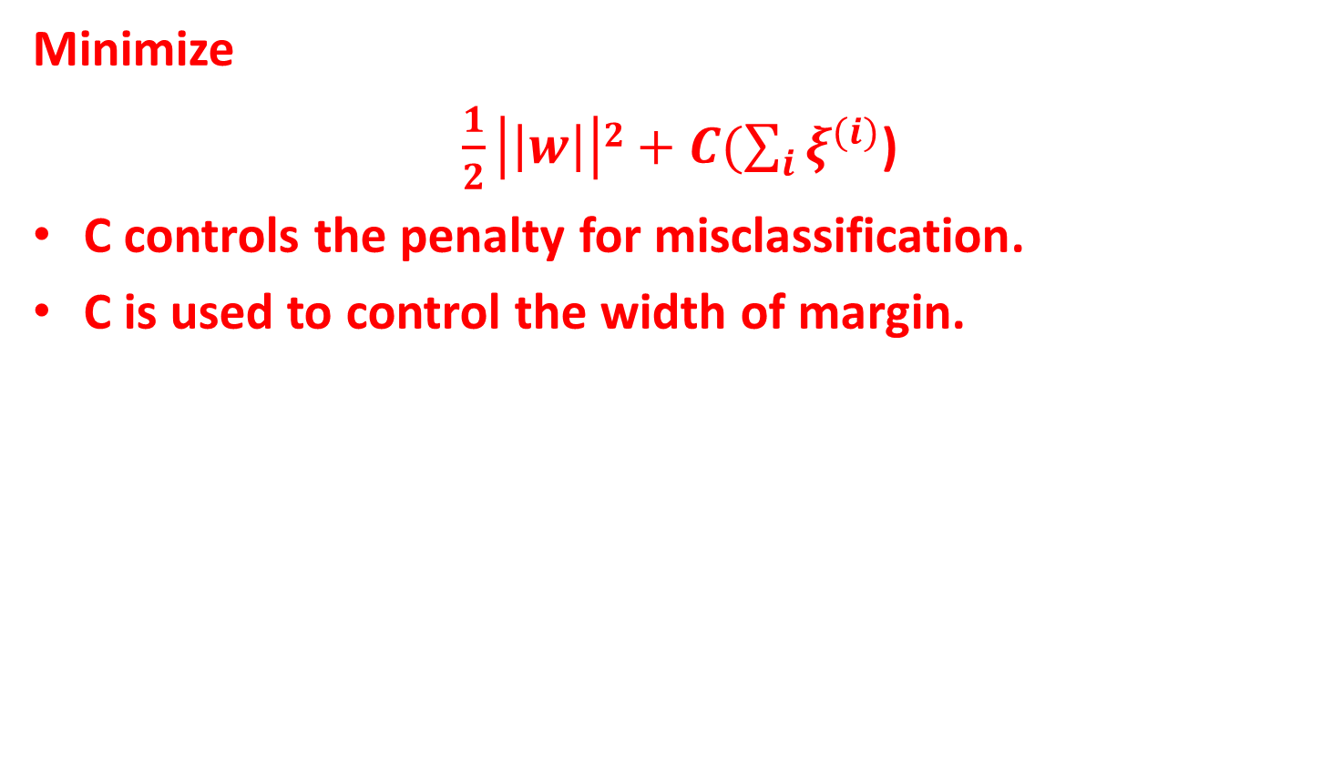
Objective Function
Minimize
$\frac{1}{2}\left|\left|w\right|\right|2+C(\sum_{i}{ξ^{(i)}}$)
C controls the penalty for misclassification.
C is used to control the width of margin.

Slide 35
Support Vector Machine (Kernels)
Linear Kernel SVM
Polynomial Kernel SVM
Radial Kernel SVM

Slide 36
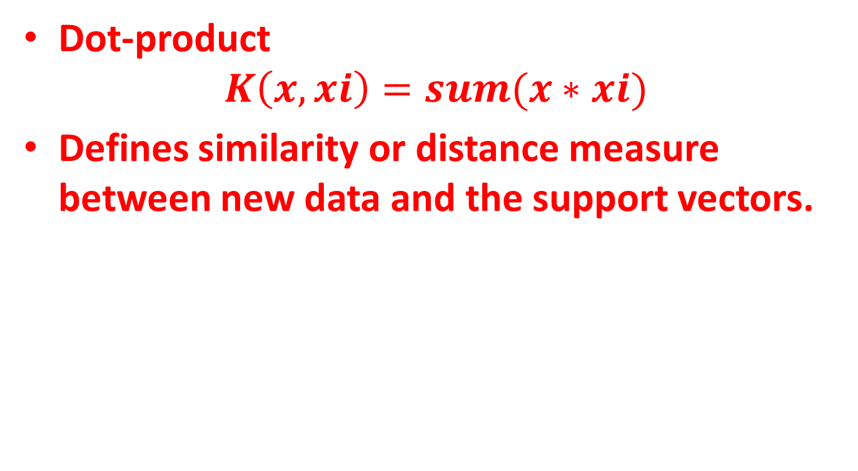
Linear Kernel SVM
Dot-product
$$K\left(x,xi\right)=sum(x∗xi)$$
Defines similarity or distance measure between new data and the support vectors.

Slide 37
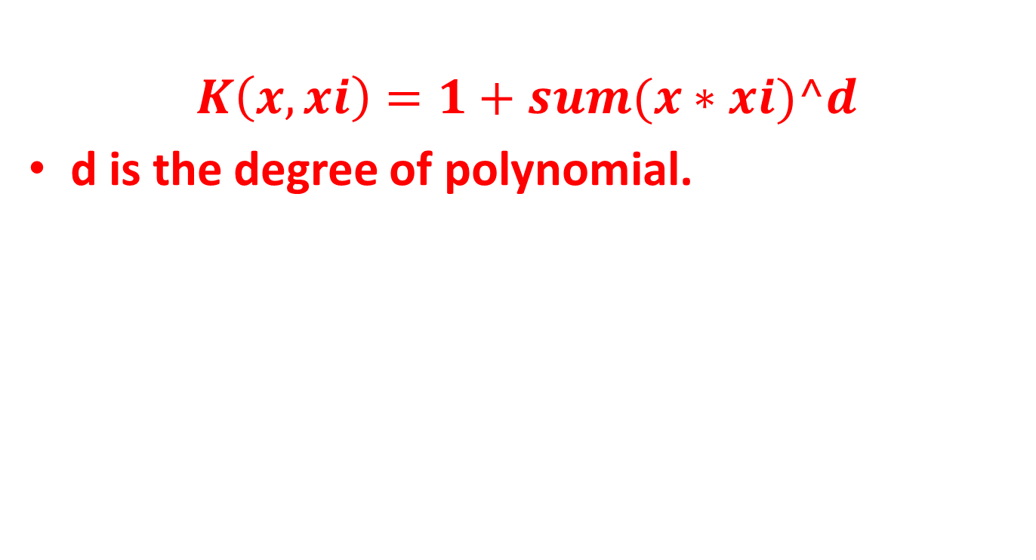
Polynomial Kernel SVM
$$K\left(x,xi\right)=1+sum(x∗xi)^d$$
d is the degree of polynomial.

Slide 38
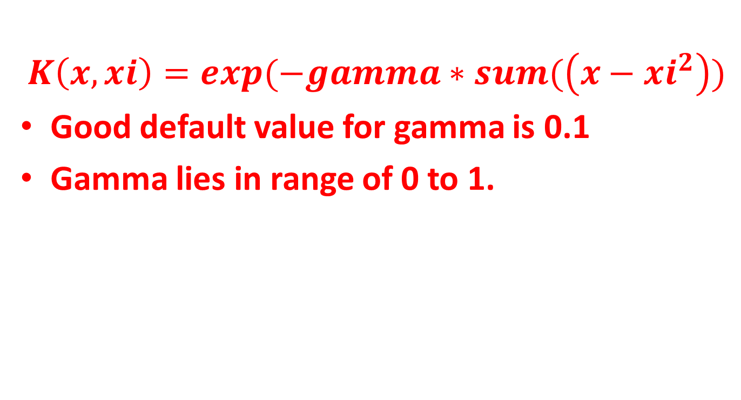
Radial Kernel SVM
$$K\left(x,xi\right)=exp(−gamma∗sum(\left(x−xi^{2}\right))$$
Good default value for gamma is 0.1
Gamma lies in range of 0 to 1.

Slide 39
SVM Advantages
Works well with unstructured data like text and images.
The kernel trick is real strength of SVM.
The risk of over-fitting is less in SVM.
It scales relatively well to high dimensional data.

Slide 40
SVM Disadvantages
Choosing a “good” kernel function is not easy.
Long training time for large datasets.
Difficult to understand and interpret the final model.

Slide 41


